Slide 1
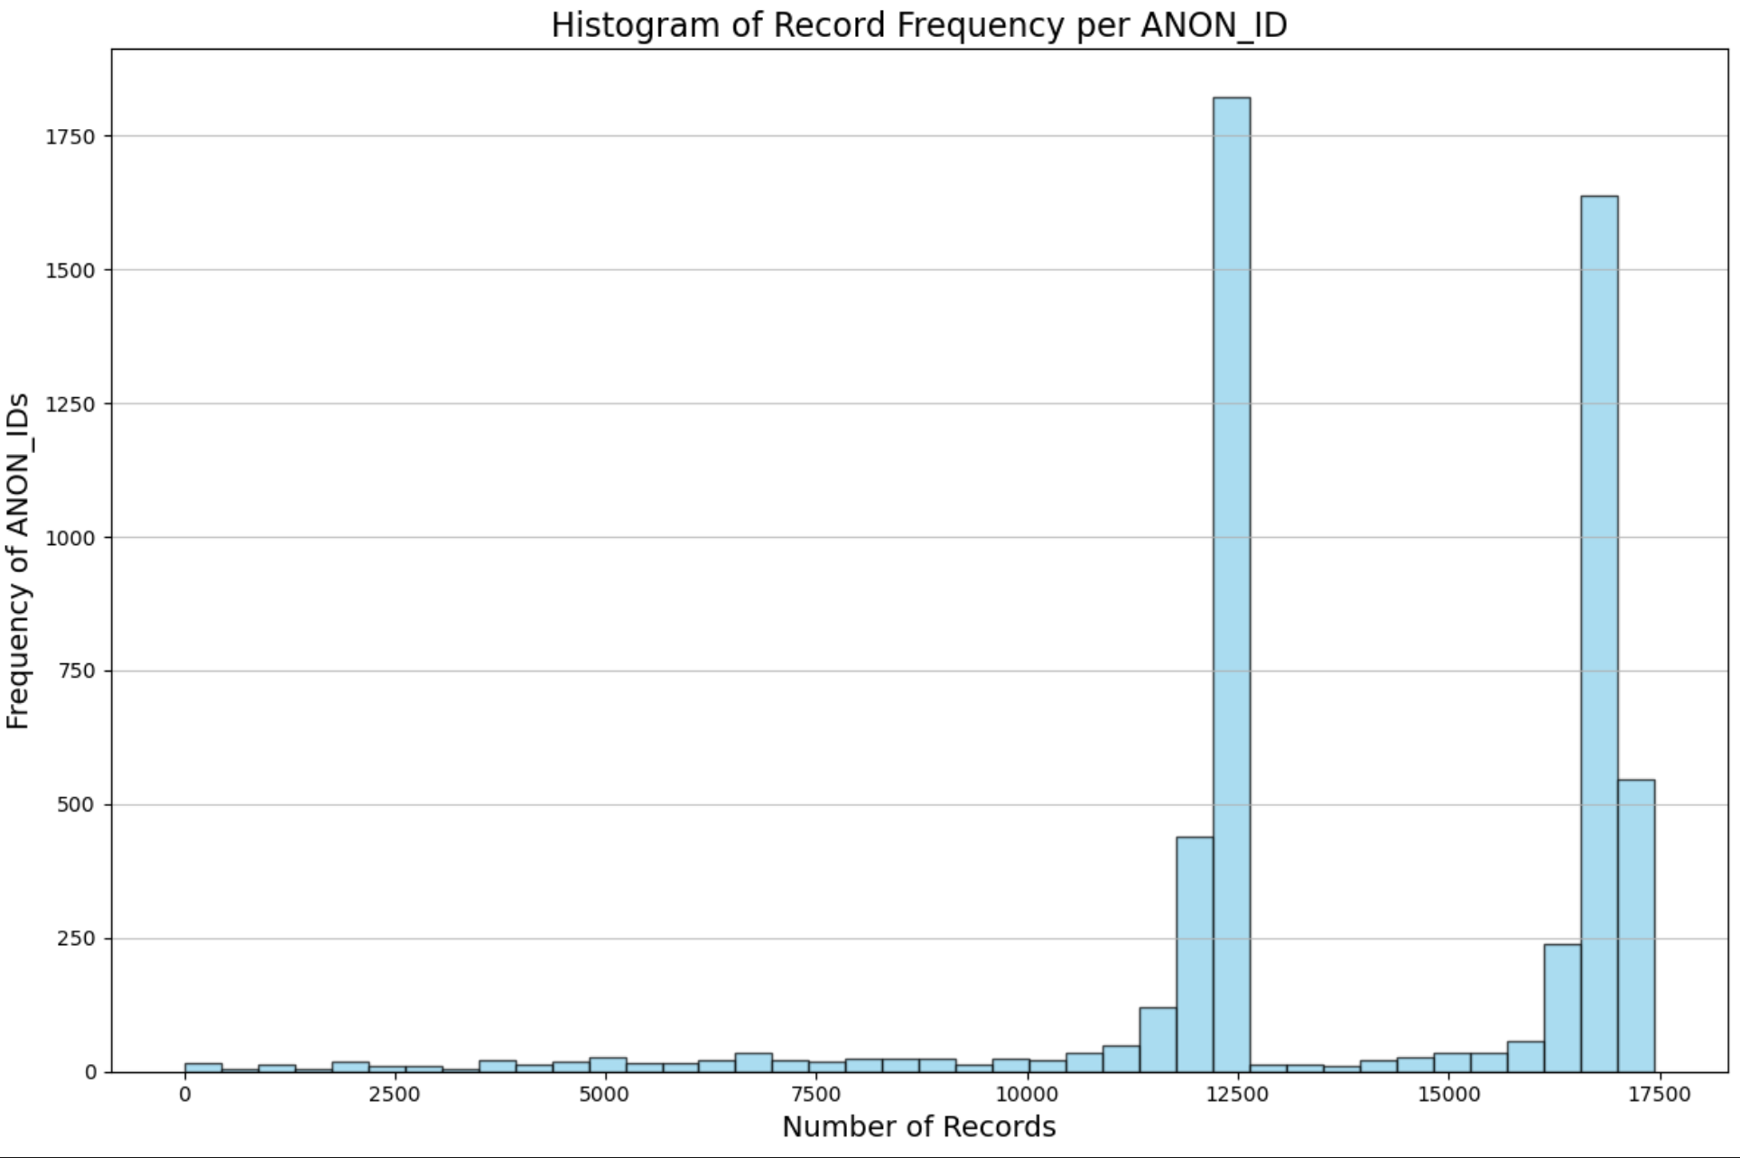

Slide 2
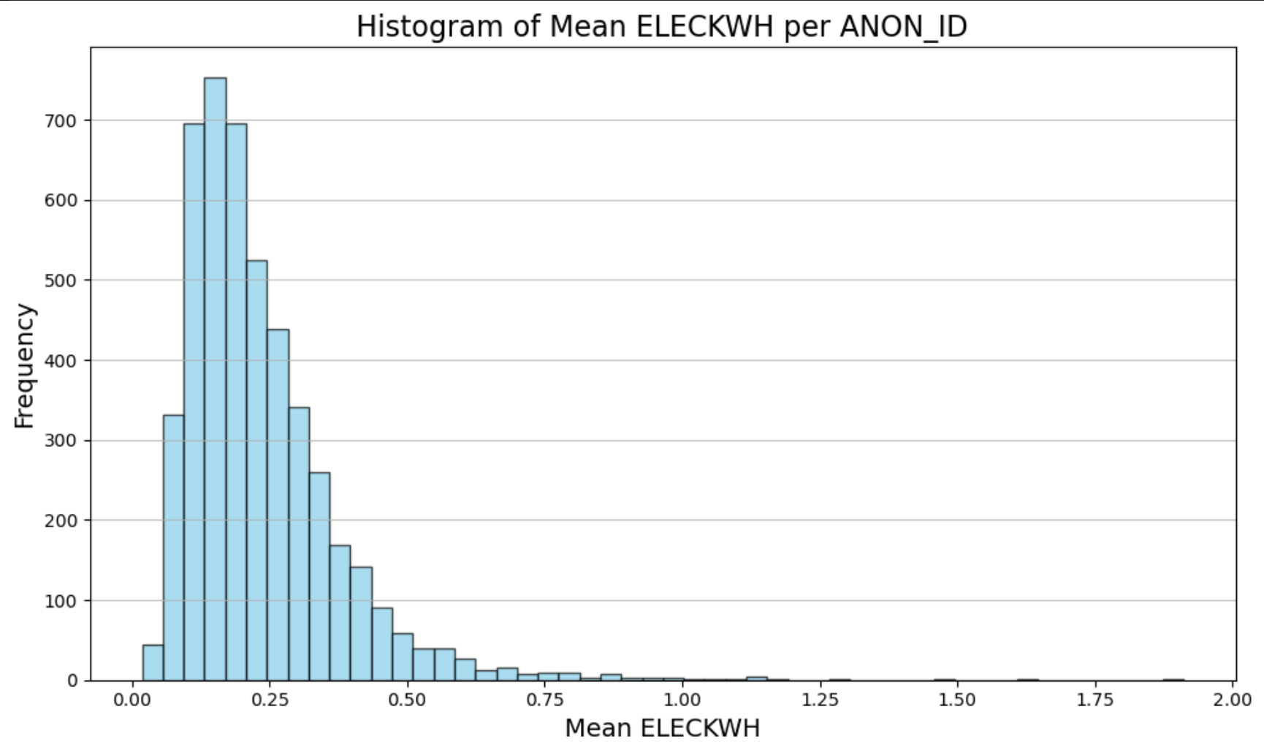

Slide 3
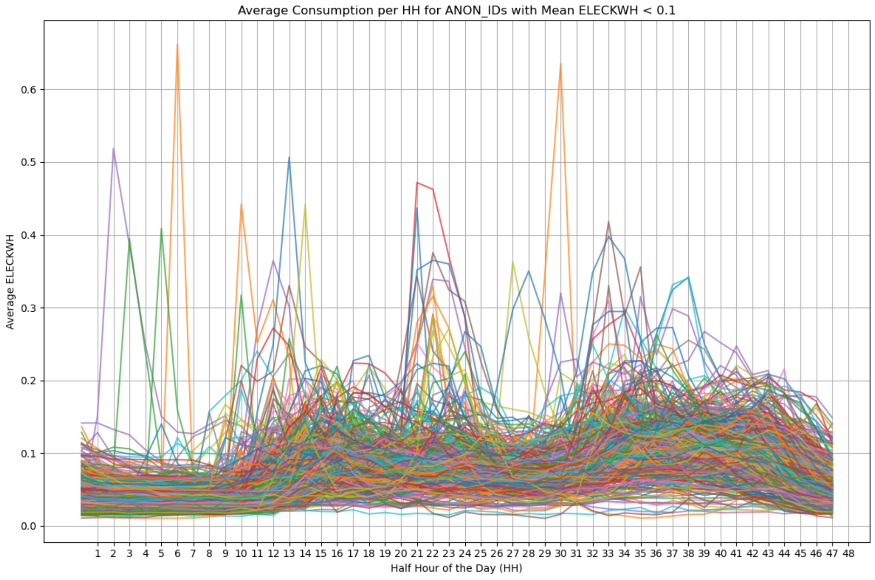

Slide 4
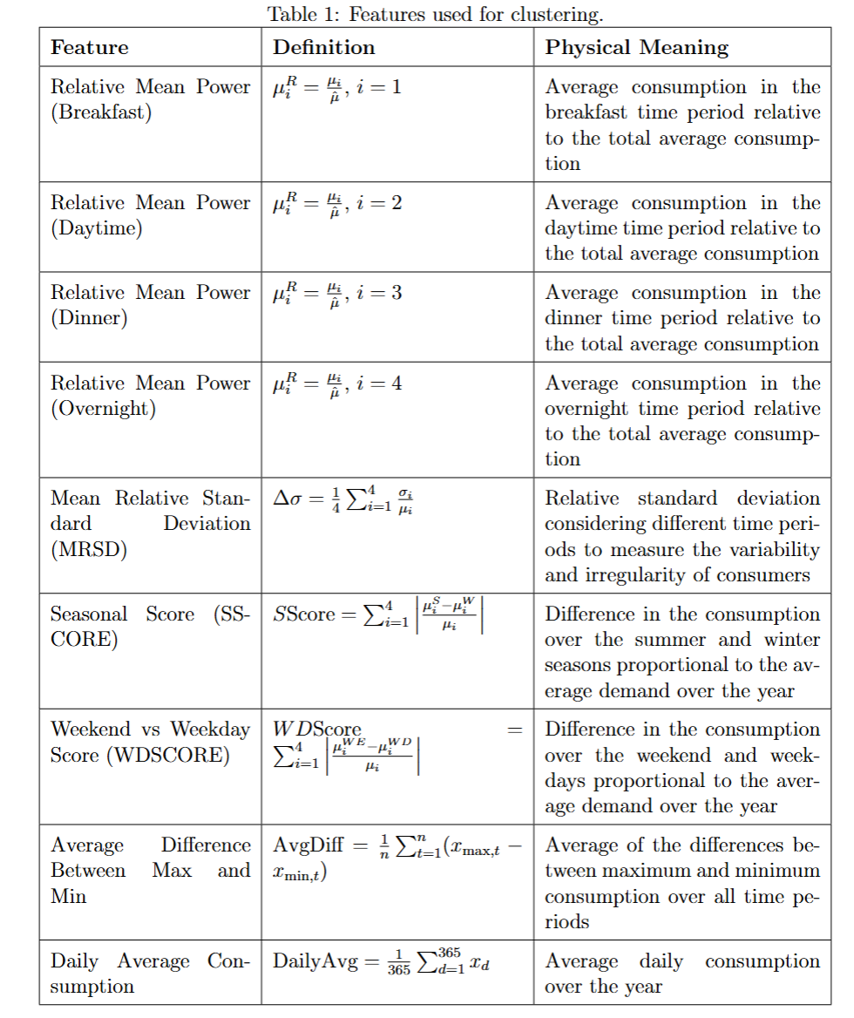
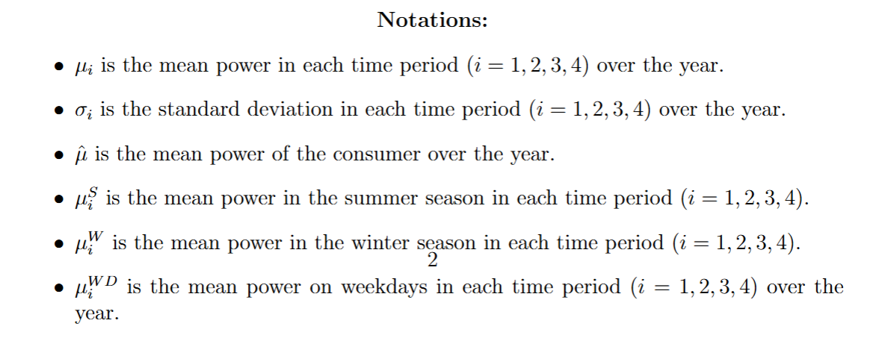
'bre' - breakfast: 6 - 10
'day' - day: 10.30 - 16
'eve' - evening: 16.30 - 22
'nig' - night: 22.30 - 5.30

Slide 5
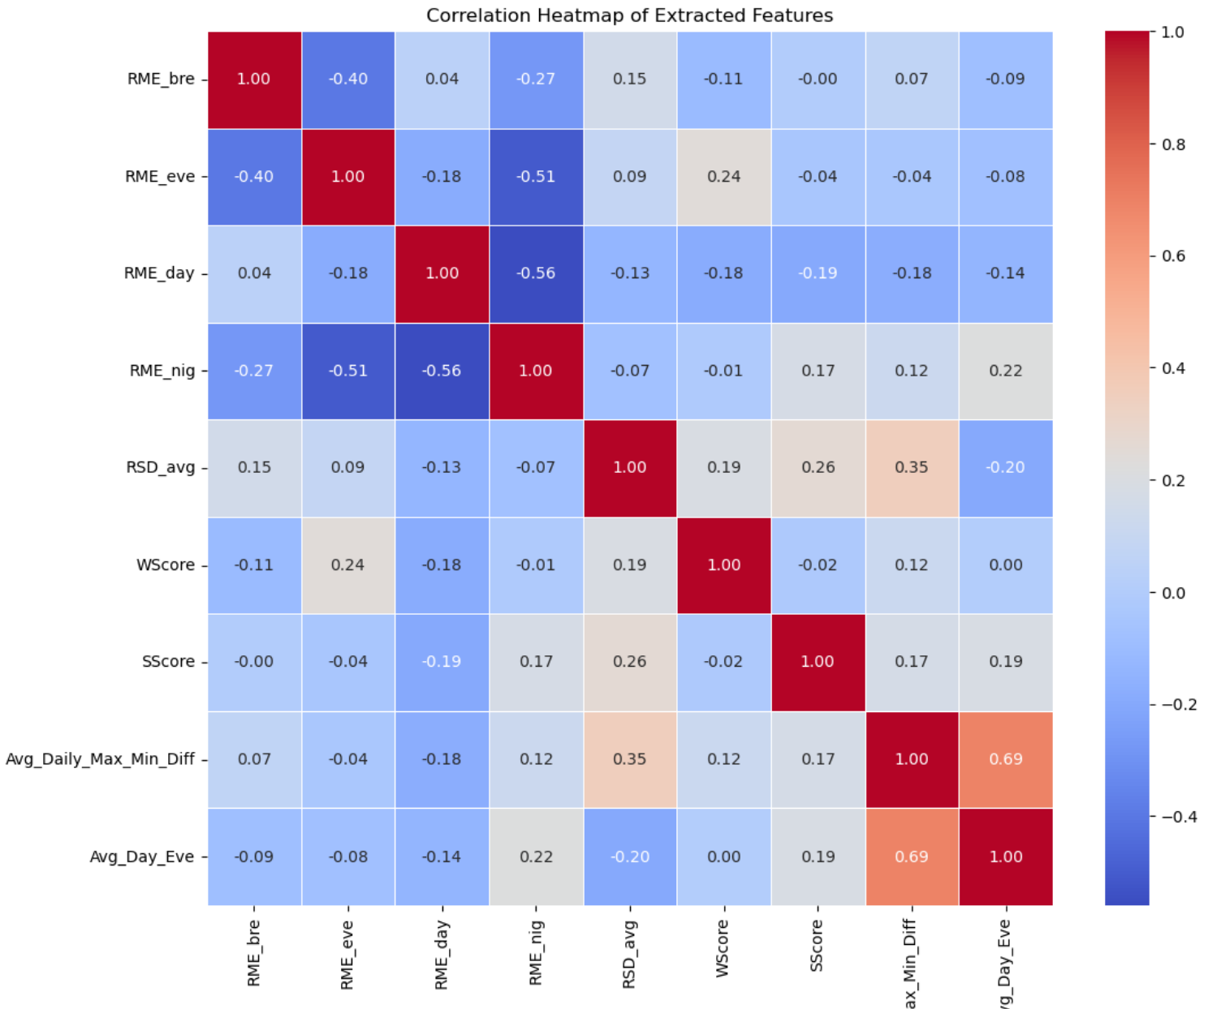

Slide 6
Electricity consumption time series of +15k Households
Data Preparation
Exploratory Data Analysis
Feature Extraction
Aggregated data
Specific Household
Prediction
Monthly bill per Houshold
Definition of Additive Method
Result Analysis:
Characterization of Profiles
Clustering
Daily consumption shape per Houshold

Slide 7
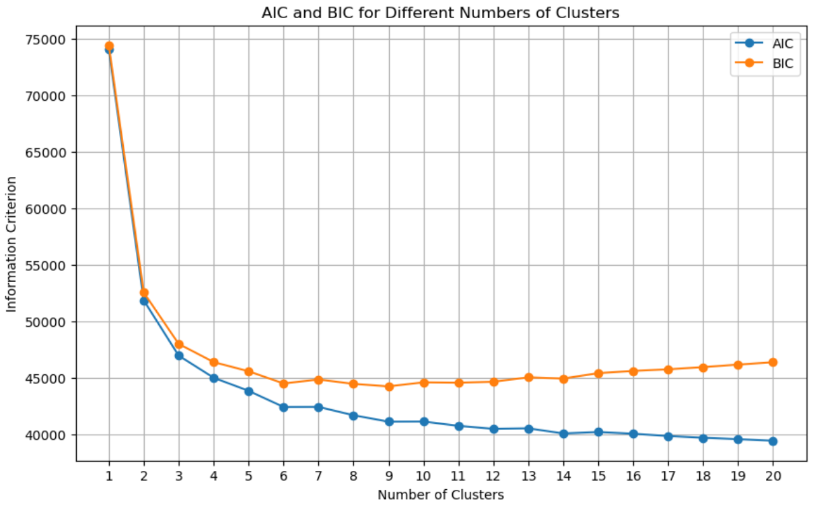
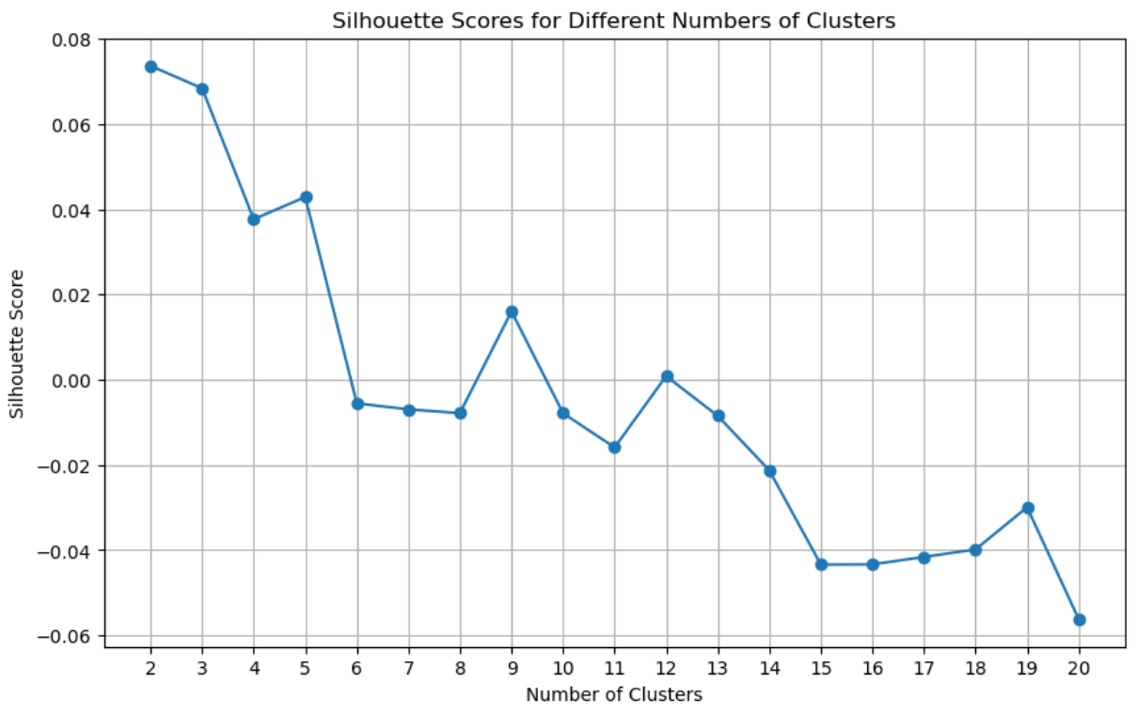

Slide 8
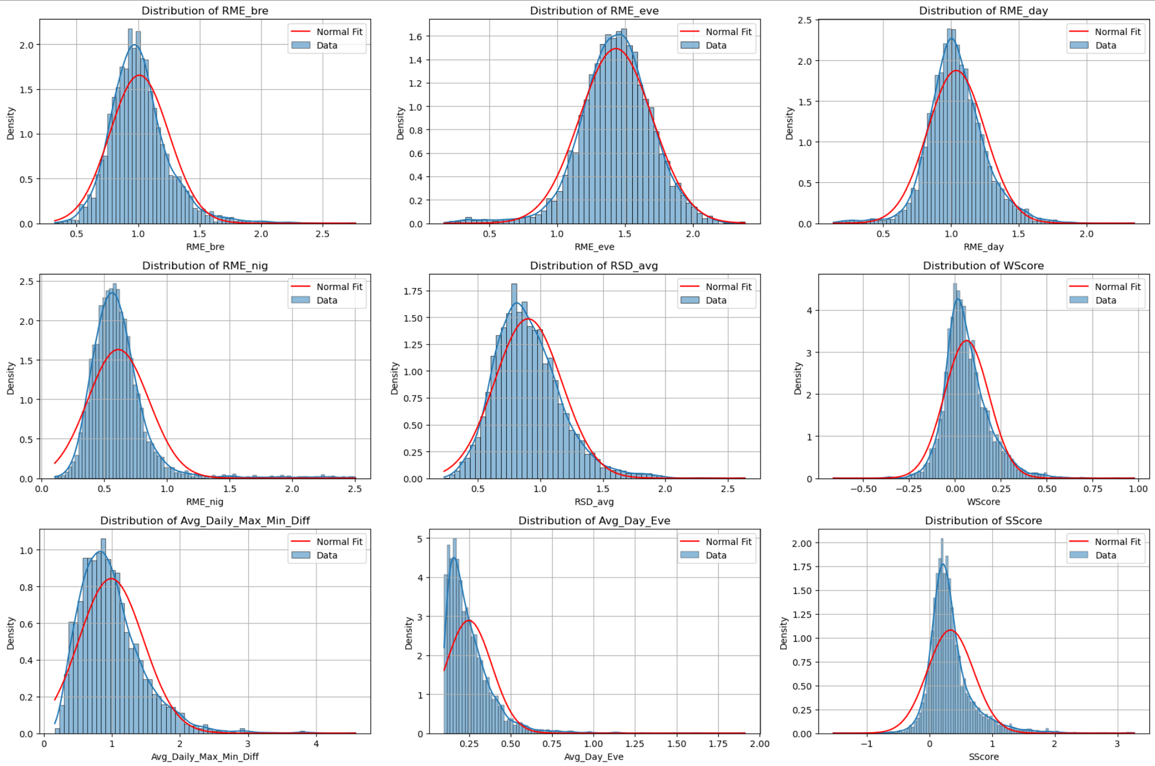

Slide 9
